Slide 1







Ethereum

Slide 2
Blockchain

Slide 3



Slide 4

Block
DATA

Slide 5

Block
Block
Blockchain
DATA
Hash
Hash
DATA

Slide 6

Block
Block
DATA
Hash
DATA
Hash
Hash
Forgery

Slide 7


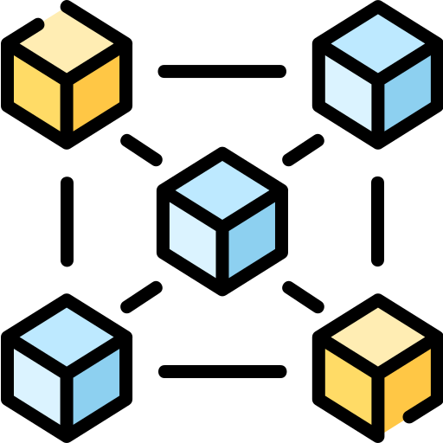


Blockchain

Slide 8



Blockchain

Slide 9



In 2013
Ethereum
Mr. Vitalik Buterin

Slide 10

Blockchain

Slide 11






Slide 12
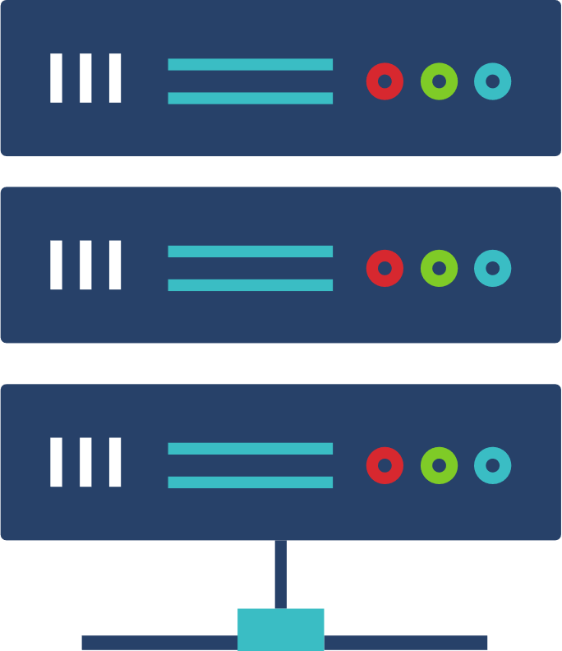

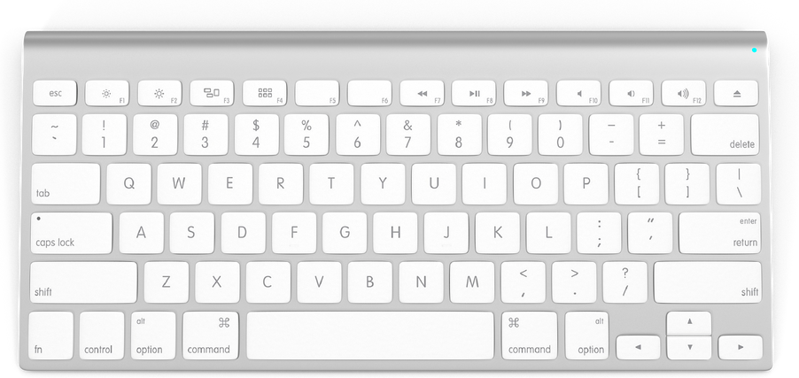



Deploy to
Server

Slide 13


Crash
Attacked

Slide 14


Not
Working

Slide 15


DApp
Decentralized Application

Slide 16




Validator

Slide 17



112,000
Baht
108,000
115,000
114,000
113,000
111,000
110,000
109,000

Slide 18




Finance
Marketplace
Game

Slide 19

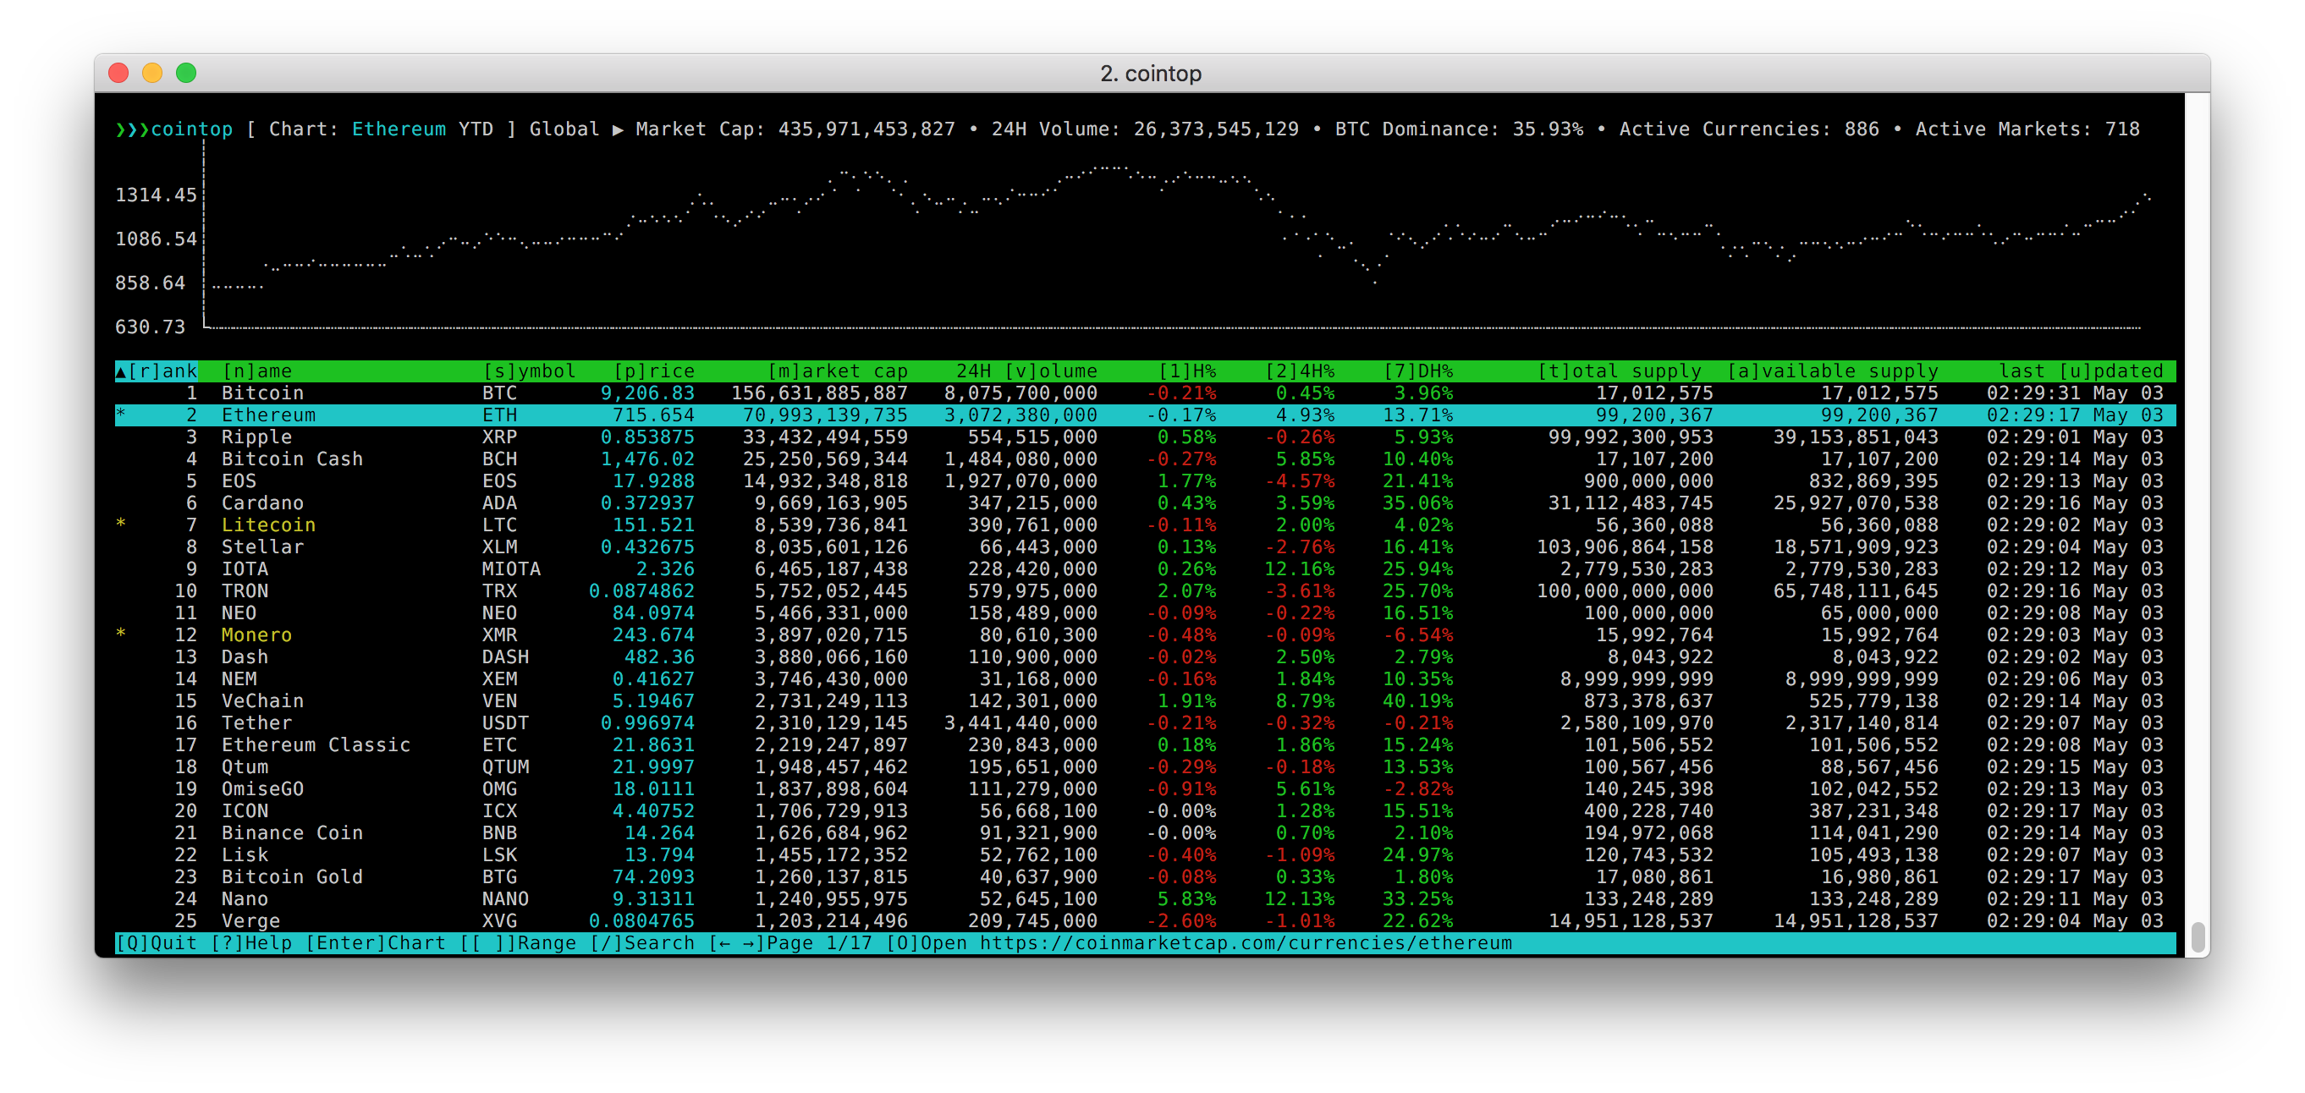
COINTOP

Slide 20




Slide 21



